Slide 1




BrainPal
BrainPal
Project Plan

Slide 2
BRAIN PAL Project Plan
Pull ISBM spec and cut out SOAP and use rest as template for BrainPal interface spec
Finish overall application partitioning, defining each expected application and interface spec
Finish object model of exchanged information and base app data model
Make JSON representation of interface models
Define REST interface specification
Define Master Workflow Builder specification
Define Master Workflow Management specification
Define mobile system Runtime Workflow Engine specification with built in actions
Define general purpose portable Runtime Workflow Engine specification
Define HMI Runtime Action Environment specification
Define Security requirements

Slide 3
BrainPal Website
BrainPal Mobile Environment
Master Environment
Specification
Runtime Action
Realization
Master Workflow
Specification
Runtime
Workflow
Execution System
with local
built-in actions
Master Workflow Specification
Vendor Website with Master workflows, environments, & actions
Runtime Action start, inputs, status, outputs, data
Runtime Environment Specification

Slide 4
BrainPal Pro Environment
Master Information Creation and Management
Create and Manage Runtime Actions
Master Environment Specification
Master Action Specification
Runtime Environment Specification
(Early Binding)
Master Workflow
Specification
Runtime Action
Realization
Master Environment Specification
Runtime Environment Specification
Runtime
Workflow
Execution System
with local
built-in actions
Runtime Environment Specification
(Late Binding)
Runtime Action Execution
Runtime Action start, inputs,
status, outputs, data

Slide 5
Master Workflow Information System
Master Environment Information System
Master Action Information System
Master Workflow
Library
Master Environment Library
Master Action
Library
Contains a
collection of
Contains a
collection of
Master Workflow
Specification
Uses 0
or more
Master Environment
Specification
References
0 or more
Master Workflow
Step Library
Used to
create a
Contains a
structured
collection of
May contain
Contains a
collection of
Contains a
collection of
Uses 0
or more
May
contain
Master Workflow
Step
May
reference a
Master Workflow
Library Step
May
Reference a
Master
Action
Specification
Is created
using
0 or more
May
reference a
May contain
Runtime Workflow Execution System
Runtime Action Execution System
Is an instance of 1 or more
Runtime Workflow
Uses a
Runtime Workflow
Environment
Runtime
Action Environment
May bind
to 0 or more
Defines a
realization
of a
Contains a structured
collection of
May contain
Identifies
instances of
May
contain
Runtime Workflow
Step
May START
Runtime
Action
Realization
Runtime
Action
Instance
When STARTED
creates a
May command a

Slide 6
Is a Type of Relationships, Parameters, & Resources
Master Workflow
Library
Master Workflow
Step Library
Master Environment Library
Master Action
Library
Runtime Workflow
Master Workflow
Specification
Runtime Workflow Step
Master Workflow
Step
Runtime Workflow
Environment
Managed Instance Element
Managed Workflow
Element
Managed Master Element
Master Environment
Specification
Runtime Action
Master
Action
Specification
Key
Has Value Property Realizations
Runtime Action Environment
Has Value Property Specifications
Is a type of relationship
Has Resource Commands
Has Resource Command Specifications
Has Resource Property Realizations
Has Resource Property Specifications
Italic indicates an abstract object

Slide 7

Proxy Step
SPLIT
Workflow Step Connection
MES
Scan Material
X
No
Assign Local Lot ID
X
Store Material
End
Start
Planned
Yes
END
START
Get ERP Lot ID
ERP
JOIN
Workflow Proxy

Slide 8
Monitoring System
Runtime Workflow Execution System
Runtime Action Execution System
GET (send MasEnvSpec IDs : returns RunActEnvs)
Create
RunWFStepInst
POST (send RunWFStepInst ID,RunActReal ID : returns RunActInstID)
Create
RunActInst
PUT (send RunActInstID, command, input parameter values : returns current status)
RunActInst
Starts
GET (send RunActInst ID, parameter IDs : returns RunActInst status & parameter values)
RunActInst
Executes
GET (send RunActInst ID, parameter IDs : returns RunActInst status & parameter values)
PUT (sends RunWFStepInst ID, retuns RunActInst status , and output parameter values
RunActInst
Completes

Slide 9
Runtime Workflow Step & Runtime Action Instance State Mode
Opaque Steps and Actions
SC when opaque and all resources acquired
Held
Held
Held
POSTED
SC
RECEIVED
SC
IN PROGRESS
SC
Observable Steps and Actions
Held
COMPLETED
Held
Held
Held
IDLE
START
Held
UNHOLDING
UNHOLD
HELD
(Internal)
SC
HOLDING
WAITING
SC
SC
Held
HOLD
CLEARING
Held
Held
Held
SC
STARTING
SC
EXECUTING
SC
COMPLETING
CLEAR
SC when observable and all resources acquired
Held
SUSPEND
ABORTED
SC
SC
Held
RESUME
Held
Held
UNPAUSING
PAUSED
(External)
SC
PAUSING
ABORT
Held
SC
ABORTING
STOP
Held
SC
STOPPING

Slide 10
Create Master
Workflow
Information
Create Runtime Workflows
Create Runtime Actions
Master
Workflow
Information
Collection
Master Environment
Master Environment
Master Workflows
Master Action
Specifications
Runtime Workflows
(Early binding to
target environment)
Runtime Action
Environments
Runtime Actions
Runtime Workflow
Environments
Runtime Action
Environments
Bind Runtime to
Action Environments
(Late binding to
target environment)
Execute Runtime Workflows
Bind Step Instances
to Action Instances
Execute Runtime Actions
Runtime
Workflow
Information
Collection
Runtime
Action
Information
Collection
Action Command
and Response
Communication

Slide 11
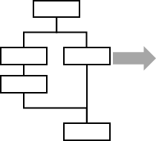
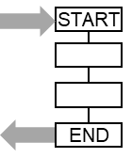
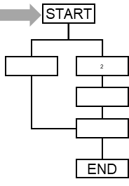
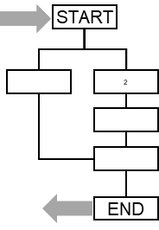
Back
Action
Notification
Back
Master
WF
Master
WF
Select
Enter initial
information
and approval
to start
Active
step list
Select
Step
Action specified
user interface
Triggers
Action
Active workflow list
Action
Executes
MENU
Start
Cancel
MENU
OK
Cancel
Action
Notification
Back
Workflow
running in Device 1
START
Workflow Action Started in Device 2
START
Active
step list
Scan Material Barcode
Click OK to scan
Select Step
Parameters
2
123456
COMPLETED
Outputs
MENU
OK
END
Selected Workflow
Back
Workflow
running in Device 1
START
Workflow Started in Device 2
Active
step list
List of
past steps
Parameters
MENU
Show History
START
Selected Workflow
Back
Workflow
running in Device 1
START
Workflow Started in Device 2
Active
step list
Selected current step
END
Parameters
List of
next steps
Workflow
Started
MENU
Show Next

Slide 12

Back
Action
Notification
Back
Master
WF
Master
WF
Action specified
user interface
Active
step list
Select
Step
Action specified
user interface
Triggers
Action
Active workflow list
Select
Action
Executes
MENU
OK
MENU
OK
Cancel
Workflow
running in Device 1
START
Workflow Action Started in Device 2
Starts remote workflow
START
Workflow
running in Device 3
START
Parameters
Parameters
2
COMPLETED
Outputs
COMPLETED
Outputs
END
Workflow
running in Device 1
START
Workflow Action Started in Device 2
Starts remote workflow
START
Workflow
running in Device 3
Workflow
running in Device 1
Triggers
Workflow
Workflow Started in Device 2
Parameters
Parameters
POSTED
COMPLETED
Outputs
START
Workflow
running in Device 1
Triggers
Workflow
Workflow Started in Device 2
END
Workflow
Started

Slide 13
Room Checkout
Cake Recipe
Steam Clean
Enter Material
Have you finished the checkout procedure
Prepare Ingredients
☑ 2 Eggs
☑ 1 Cup Water
☑ ½ teaspoon salt
☑ 1 cup flour
…
Start one-minute clean cycle
Click OK when you start
Scan Barcode
Click OK to scan
Yes
No
Done
OK
OK
Ok Box:
“Run 1 mile”
“Click OK when you start”
Yes No Question:
“Have you finished your 1 mile run?”
Yes
Ok Box:
“Do 50 Pull Ups”
“Click OK when you start”
No

Slide 14
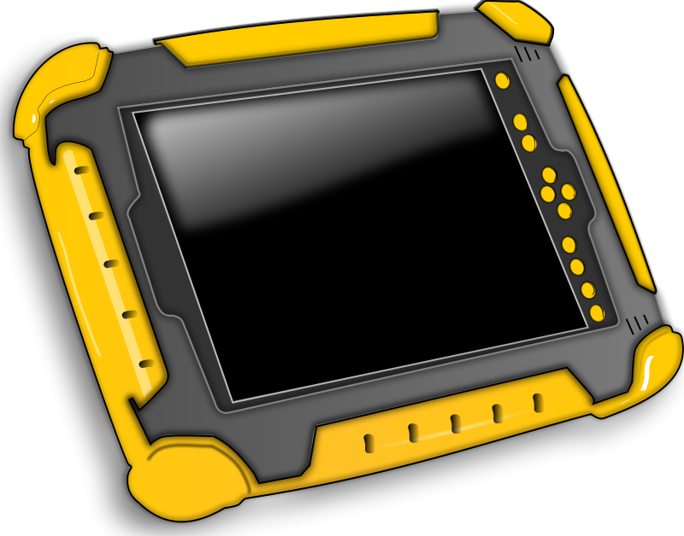


Same Workflow
Different Local Execution Environments
Runtime Workflow
executing
in Device 1
Execution Environment #1
selected with environment
specific action logic
Execution Environment #2
selected with environment
specific action logic
Execution Environment #3
selected with environment
specific action logic
Execution Environment #1
Execution Environment #2
Execution Environment #3
Runtime Workflow
executing
in Device 1
Execution Environment #1
selected with environment
specific action logic
Execution Environment #2
selected with environment
specific action logic

Slide 15
BrainPal
Task
Call Activity
Gateway
+
←
Lane
Pool
No Wait
Wait
Lane
Transaction
Event
Sub-Process
X
Parallel
Gateway
Event-based
Gateway

−
Sub Workflow
Math
Pool


−
Start
Task
Gateway
Start


−
End
+
No
Yes


−
Select
Split

Merge
Join




Slide 16
Master Workflow Information System
UML Component Diagrams
Master Information
Management System
Master Environment
<<provided interfaces>>
GetMasterWorkflow
GetMasterEnvironment
GetMasterActionSpecification
GetMasterWorkflowLibrary
GetMasterEnvironmentLibrary
GetMasterActionLibrary
Master Action Specification
Master Workflow
Master Environment
Runtime Workflow
Execution System
Runtime Action
Execution System
<<uses interfaces>>
GetMasterWorkflow
GetMasterEnvironment
GetMasterWorkflowLibrary
GetMasterEnvironmentLibrary
<<uses interfaces>>
GetMasterEnvironmentLibrary
GetMasterEnvironment
GetMasterActionLibrary
GetMasterActionSpecification

Slide 17
UML Component Diagrams
Runtime Workflow
Execution System
Runtime Action
Execution System
<<provides interfaces>>
ReportActionState
ReportActionData
<<uses interfaces>>
BindStepToAction
StartAction
Bind Step to Action
<<provides interfaces>>
BindStepToAction
StartAction
<<uses interfaces>>
ReportActionState
ReportActionData
Start Action
Report State and Data

Slide 18
Workflow Specification

Slide 19
Start
Example, workflow specification in flowchart format
Scan
Material
Get ERP
Lot ID
Yes
Planned
No
Assign
Local Lot ID
Planned
Store
Material
Stop

